Slide 1
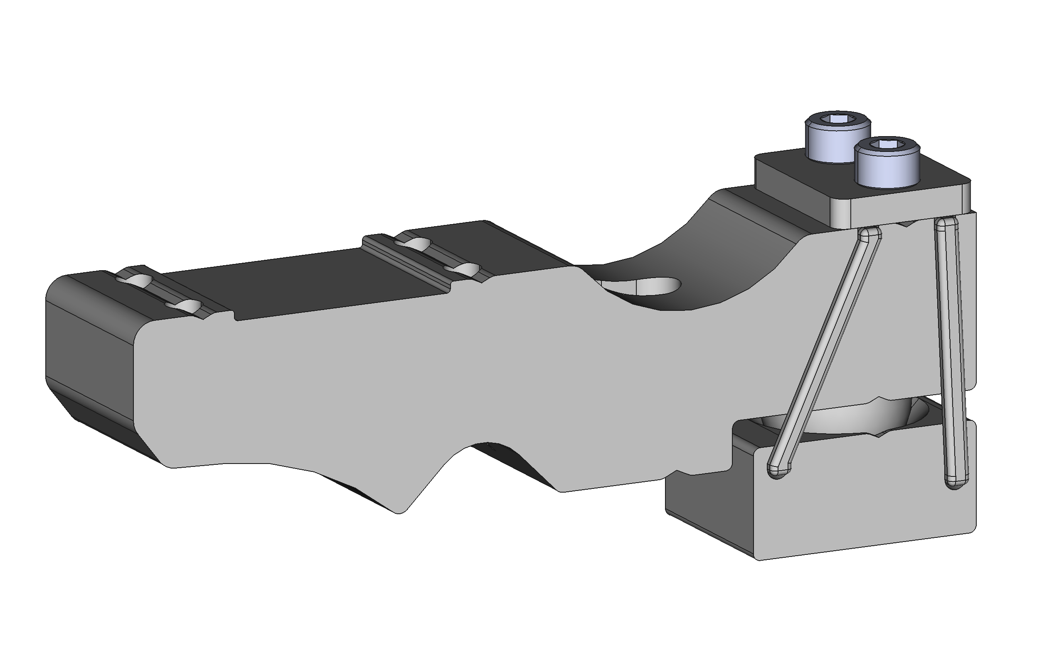
Adjust strips/cord to produce a slight upward angle of jaw relative to clamp body

